Slide 1

k. PRATHYuSHA- 1602-14-737-094 p. SMAYANA – 1602-14-737-109
MY WEB GUIDE

Slide 2







TOUR OPERATORS

Slide 3

Disadvantages of Taking Guide
Planning
Travelling too quickly
Lack of flexibility
Limited interaction with locals
Expensive
Stick to group always

Slide 4



Introduction
MyWebGuide is a Travel webpage That Can Replace Your Tour Guide
MyWebGuide helps to plan trip in the most efficient way

Slide 5
Features
Locals suggested places
Offline maps-routes
Transport availability
Things to buy ( where, how much)
Details(entry fee , timings , phone no…)

Slide 6
Languages used
HTML
CSS
BOOTSTRAP
JAVASCRIPT

Slide 7
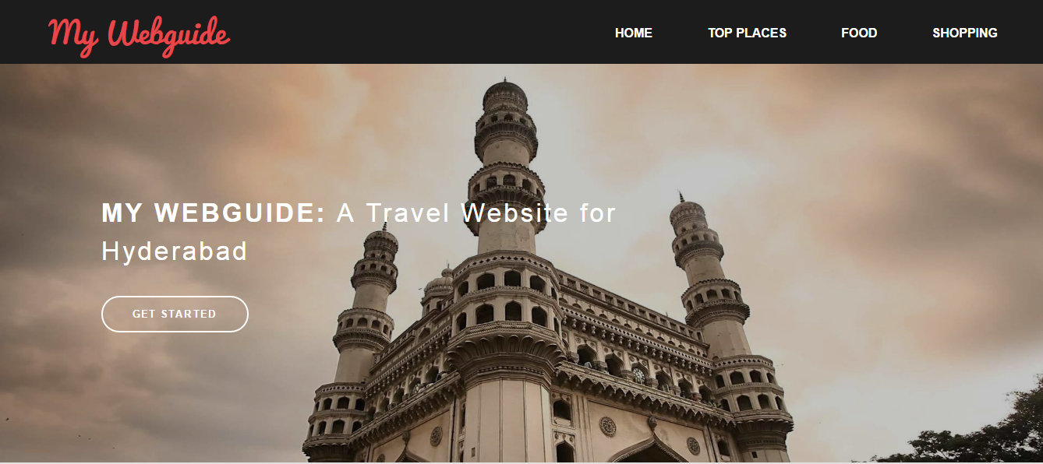
screenshots

Slide 8
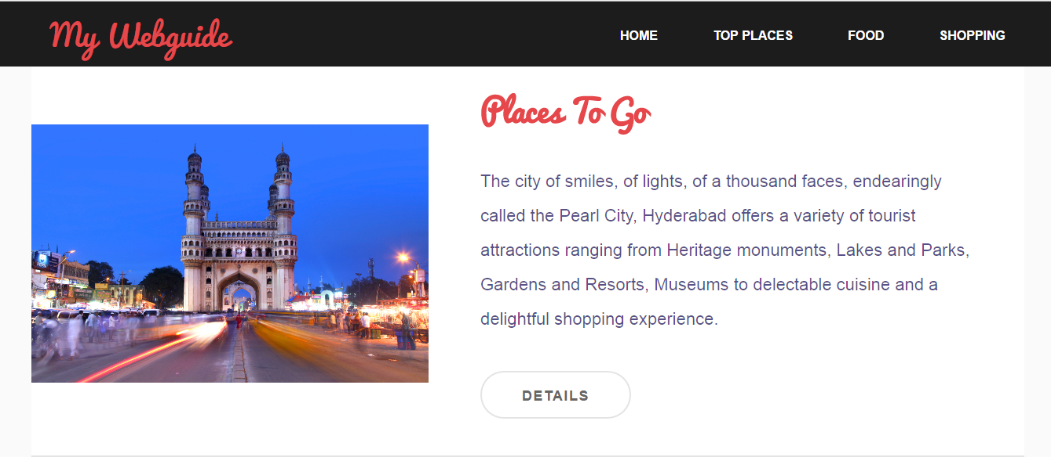

Slide 9
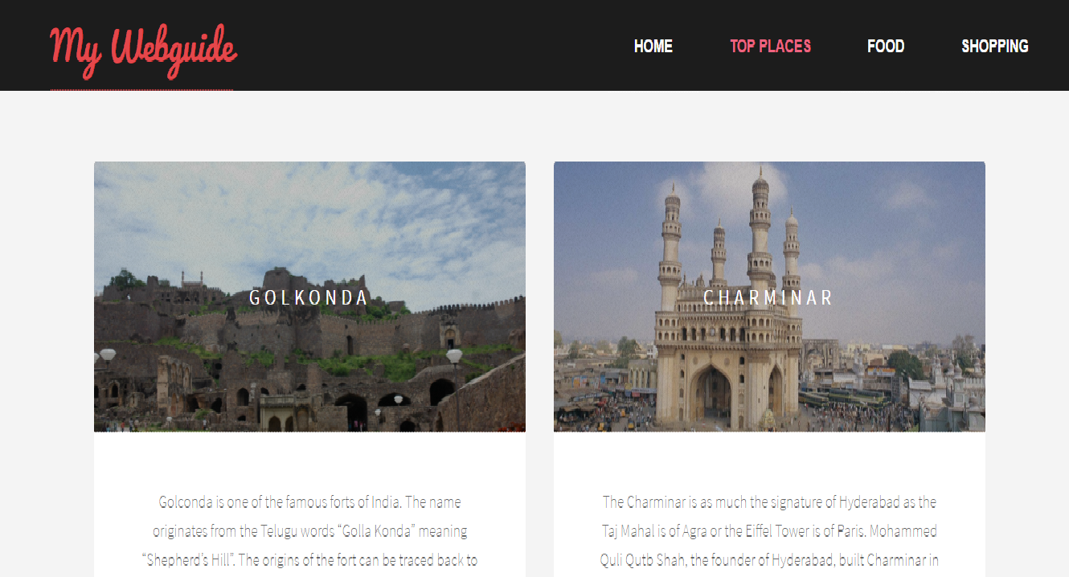

Slide 10
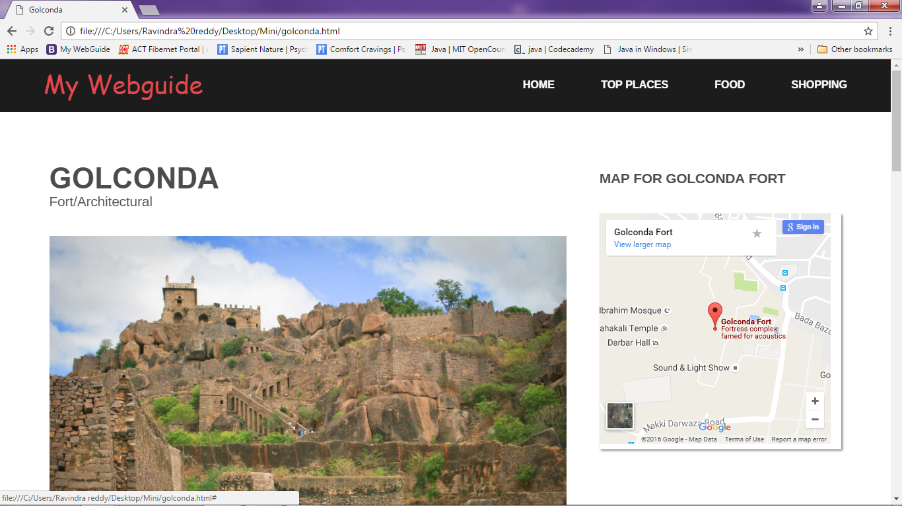
Offline map and transport details and things to by

Slide 11
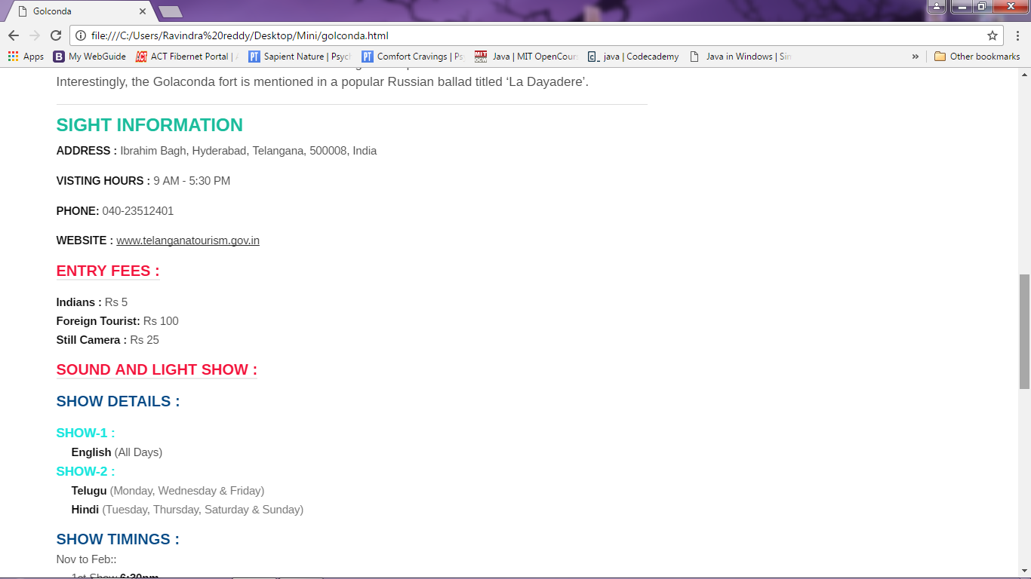
Details

Slide 12
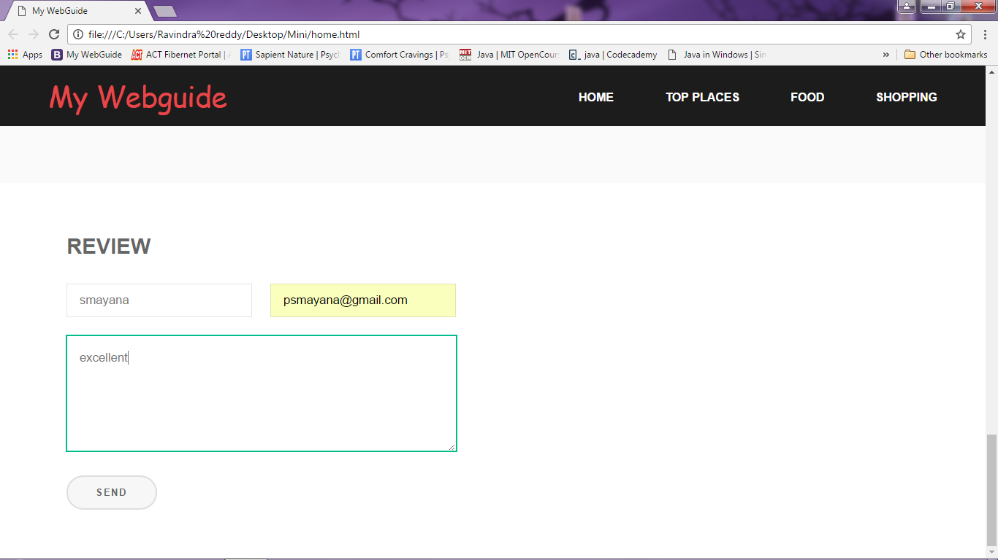

Slide 13

QUERIES?

Slide 14

THANK YOU

